Slide 1

Digital Design
Chapter 4:
Datapath Components
Slides to accompany the textbook Digital Design, First Edition,
by Frank Vahid, John Wiley and Sons Publishers, 2007.
http://www.ddvahid.com
Copyright © 2007 Frank Vahid
Instructors of courses requiring Vahid's Digital Design textbook (published by John Wiley and Sons) have permission to modify and use these slides for customary course-related activities, subject to keeping this copyright notice in place and unmodified. These slides may be posted as unanimated pdf versions on publicly-accessible course websites.. PowerPoint source (or pdf with animations) may not be posted to publicly-accessible websites, but may be posted for students on internal protected sites or distributed directly to students by other electronic means. Instructors may make printouts of the slides available to students for a reasonable photocopying charge, without incurring royalties. Any other use requires explicit permission. Instructors may obtain PowerPoint source or obtain special use permissions from Wiley – see http://www.ddvahid.com for information.

Slide 2
Introduction
4.1
Chapters 2 & 3: Introduced increasingly complex digital building blocks
  Gates, multiplexors, decoders, basic registers, and controllers
Controllers good for systems with control inputs/outputs
  Control input: Single bit (or just a few), representing environment event or state
    e.g., 1 bit representing button pressed
  Data input: Multiple bits collectively representing single entity
    e.g., 7 bits representing temperature in binary
Need building blocks for data
  Datapath components, aka register-transfer-level (RTL) components, store/transform data
    Put datapath components together to form a datapath
This chapter introduces numerous datapath components, and simple datapaths
  Next chapter will combine controllers and datapaths into “processors”
si
ansis
e
z
Note: Slides with animation are denoted with a small red "a" near the animated items

Slide 3
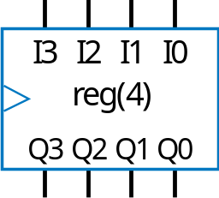
Registers
4.2
Can store data, very common in datapaths
Basic register of Ch 3: Loaded every cycle
  Useful for implementing FSM -- stores encoded state
  For other uses, may want to load only on certain cycles
b
x
Combinational
n1
logic
n0
s1
s0
clk
State register
a
load
I
3
I
2
I
1
I
0
4-bit register
D
D
D
D
si
Q
Q
Q
Q
ansis
clk
Q3
Q2
Q1
Q0
e
Basic register loads on every clock cycle
z
How extend to only load on certain cycles?

Slide 4
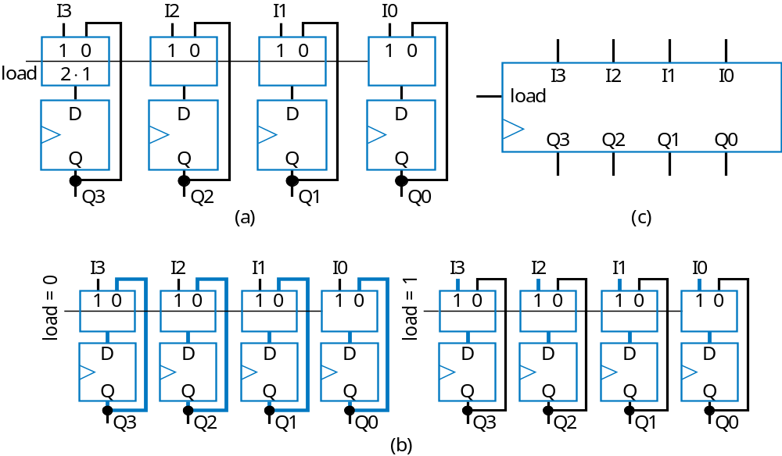
Register with Parallel Load
Add 2x1 mux to front of each flip-flop
Register’s load input selects mux input to pass
  Either existing flip-flop value, or new value to load

Slide 5
Basic Example Using Registers
a3
a2
a1
a0
This example will show how registers load simultaneously on clock cycles
  Notice that all load inputs set to 1 in this example -- just for demonstration purposes
1
ld
I
3
I
2
I
1
I
0
clk
R0
Q3
Q2
Q1
Q0
1
ld
I
3
I
2
I
1
I
0
1
ld
I
3
I
2
I
1
I
0
R1
R2
Q3
Q2
Q1
Q0
Q3
Q2
Q1
Q0

Slide 6
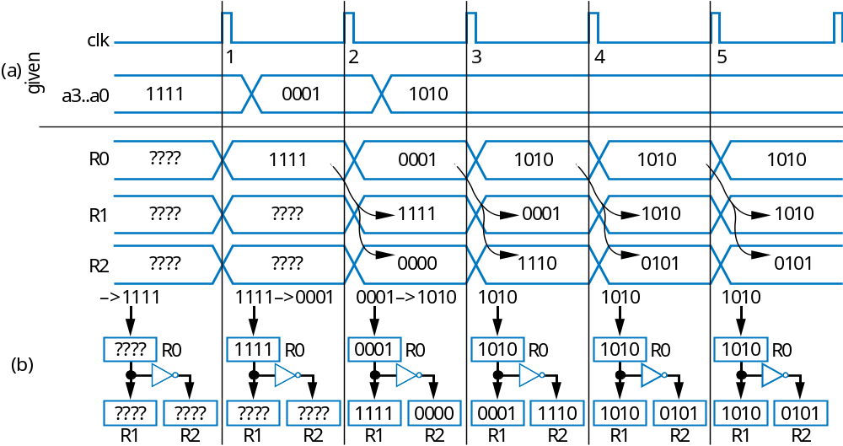
Basic Example Using Registers
a3
a2
a1
a0
I
3
I
2
I
1
I
1
ld
0
clk
Q3
Q2
Q1
R0
Q0
I
3
I
2
I
1
I
0
I
3
I
2
I
1
I
1
ld
1
ld
0
R1
R2
Q3
Q2
Q1
Q0
Q3
Q2
Q1
Q0

Slide 7

Register Example using the Load Input:
Weight Sampler
Scale has two displays
  Present weight
  Saved weight
  Useful to compare present item with previous item
Use register to store weight
  Pressing button causes present weight to be stored in register
    Register contents always displayed as “Saved weight,” even when new present weight appears
Scale
Weight Sampler
0
0
0
0
1
1
1
0
Save
b
1
I
3
I
2
I
1
I
0
3 pounds
a
2 pounds
load
0
0
1
1
Present weight
clk
Q3
Q2
Q1
Q0
3 pounds
Saved weight

Slide 8
Register Example: Temperature History Display
Recall Chpt 3 example
  Timer pulse every hour
  Previously used as clock. Better design only connects oscillator to clock inputs -- use registers with load input, connect to timer pulse.
a4
a3
a2
a1
a0
b4
b3
b2
b1
b0
c4
c3
c2
c1
c0
a4
a3
a2
a1
a0
b4
b3
b2
b1
b0
c4
c3
c2
c1
c0
t4
I
4
Q4
I
4
Q4
I
4
Q4
I
I
4
Q4
I
4
Q4
I
4
Q4
x4
3
Q3
I
3
Q3
I
3
Q3
t3
I
I
3
Q3
I
3
Q3
I
3
Q3
x3
2
Ra
Q2
I
2
Rb
Q2
I
2
Rc
Q2
t2
I
I
2
Q2
I
2
Q2
I
2
Q2
x2
1
Q1
I
1
Q1
I
1
Q1
t1
I
I
1
Q1
I
1
Q1
I
1
Q1
x1
0
Q0
I
0
Q0
I
0
Q0
t0
I
0
Q0
I
0
Q0
I
0
Q0
x0
ld
ld
ld
osc
C
Clk
R
a
R
b
R
c
C
TemperatureHistoryStorage
a
timer
new line
TemperatureHistoryStorage

Slide 9
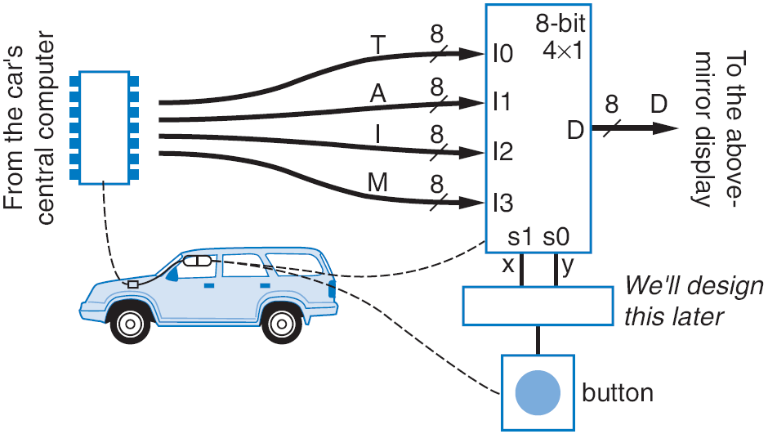
Register Example: Above-Mirror Display
8
Shorthand notation
0001010
a
C
8
Loaded on clock edge
er
t
d0
load
r
eg0
T
ompu
i0
mi
T
c
2
⋅
4
o the ab
al
8
r
r
1
r
t
or displ
om the car's
0
8-bit
r
n
F
d1
load
Ch2 example: Four simultaneous values from car’s computer
To reduce wires: Computer writes only 1 value at a time, loads into one of four registers
  Was: 8+8+8+8 = 32 wires
  Now: 8 +2+1 = 11 wires
e
r
eg1
A
×
c
a0
0001010
4
1
o
i0
i1
a
v
1
y
e
i1
8
a1
d2
load
d
D
r
eg2
I
8
i2
8
d3
load
r
eg3
M
1
e
load
i3
s1
s0
8
x
y

Slide 10
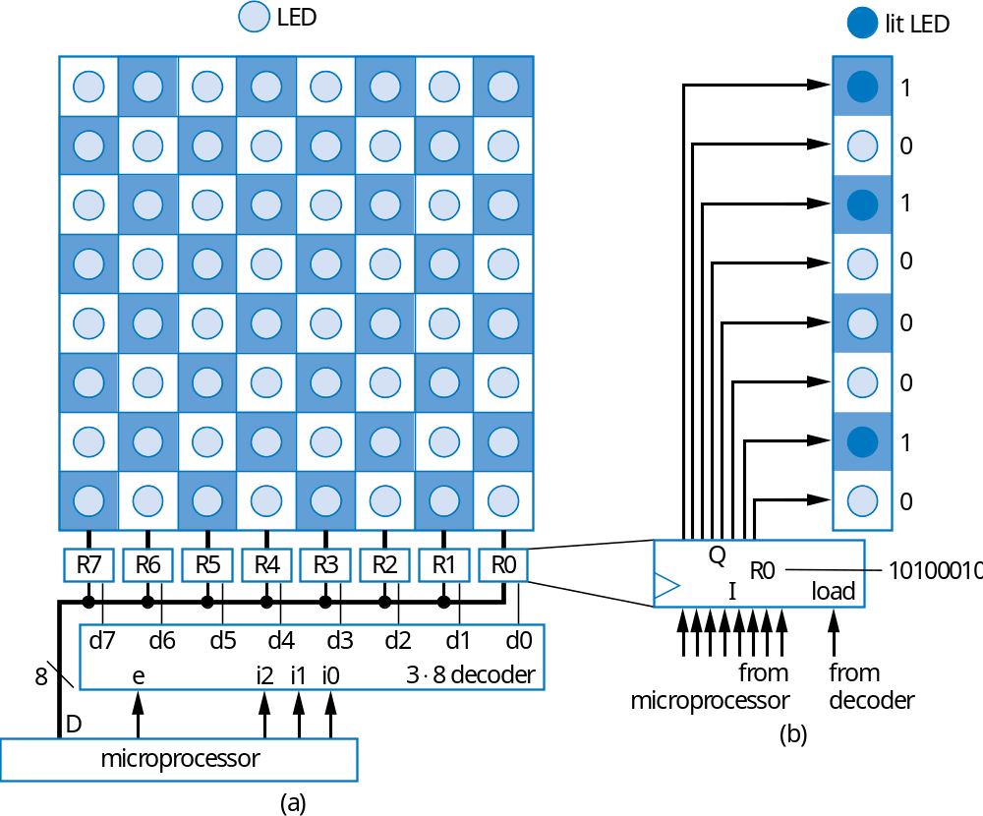
Register Example: Computerized Checkerboard
Each register holds values for one column of lights
  1 lights light
Microprocessor loads one register at a time
  Occurs fast enough that user sees entire board change at once

Slide 11
Register Example: Computerized Checkerboard
LED
lit LED
R7
R6
R5
R4
R3
R2
R1
R0
10100010
10100010
10100010
10100010
01000101
01000101
01000101
01000101
D
10100010
010000101
10100010
010000101
10100010
010000101
10100010
010000101
i2,i1,i0
000 (R0)
001 (R1)
010 (R2)
011 (R3)
100 (R4)
101 (R5)
110 (R6)
111 (R7)
e
clk

Slide 12
Shift Register
1 1 0 1
Register contents
Shift right
  Move each bit one position right
  Shift in 0 to leftmost bit
before shift right
0
a
0 1 1 0
Register contents
after shift right
Q: Do four right shifts on 1001, showing value after each shift
A:
1001 (original)
a
0100
0010
Implementation: Connect flip-flop output to next flip-flop’s input
0001
shr_in
a
0000

Slide 13
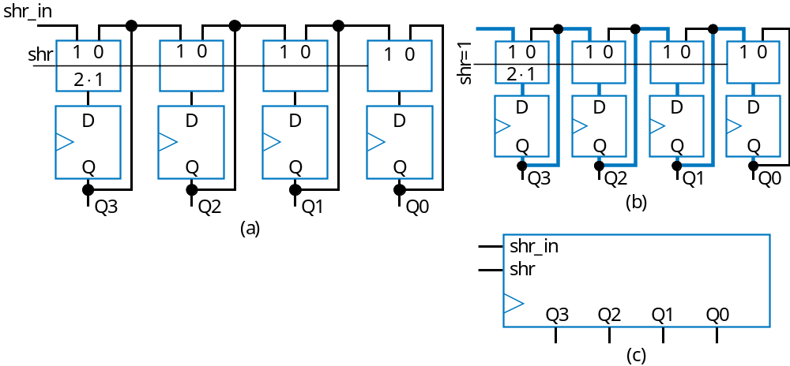
Shift Register
To allow register to either shift or retain, use 2x1 muxes
  shr: 0 means retain, 1 shift
  shr_in: value to shift in
    May be 0, or 1
Note: Can easily design shift register that shifts left instead

Slide 14
Rotate Register
1 1 0 1
Register contents
Rotate right: Like shift right, but leftmost bit comes from rightmost bit
before shift right
1 1 1 0
Register contents
after shift right

Slide 15
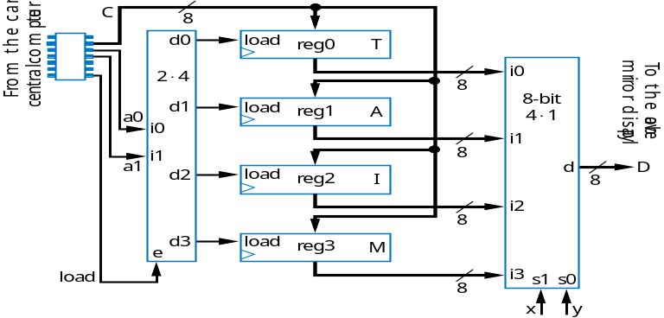
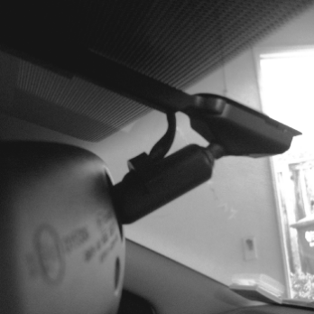
Shift Register Example: Above-Mirror Display
Earlier example: 8 +2+1 = 11wires from car’s computer to above-mirror display’s four registers
  Better than 32 wires, but 11 still a lot -- want fewer for smaller wire bundles
Use shift registers
  Wires: 1+2+1=4
  Computer sends one value at a time, one bit per clock cycle
11 wires
Note: this line is 1 bit, rather than 8 bits like before
c
x
y
shr_in
d0
shr
r
eg0
T
s1
s0
2
⋅
4
i0
shr_in
8
shr
4
×
1
d1
r
eg1
A
a0
i0
i1
a1
i1
shr_in
8
shr
d
D
d2
r
8
eg2
I
i2
shr_in
8
d3
shr
r
e
eg3
M
shi
f
t
i3
8

Slide 16
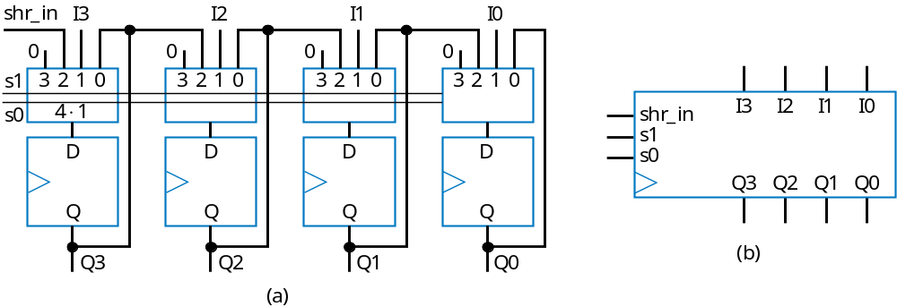
Multifunction Registers
Many registers have multiple functions
  Load, shift, clear (load all 0s)
  And retain present value, of course
Easily designed using muxes
  Just connect each mux input to achieve desired function
Functions:
s1
s0
Operation
0
0
Maintain present value
0
1
Parallel load
1
0
Shift right
1
1
(unused - let's load 0s)

Slide 17
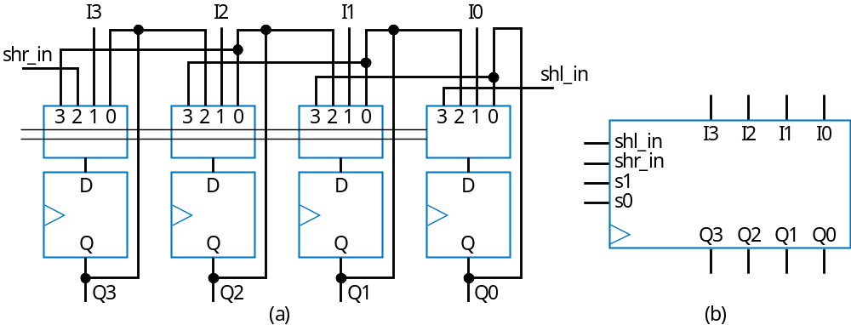
Multifunction Registers
s1
s0
Operation
0
0
Maintain present value
0
1
Parallel load
1
0
Shift right
1
1
Shift left

Slide 18
Multifunction Registers with Separate Control Inputs
ld
shr
shl
Operation
0
0
0
Maintain present value
0
0
1
Shift left
0
1
0
Shift right
0
1
1
Shift right – shr has priority over shl
1
0
0
Parallel load
1
0
1
Parallel load – ld has priority
I
3
I
2
I
1
I
0
1
1
0
Parallel load – ld has priority
shr_in
1
1
1
Parallel load – ld has priority
ld
shr_in
I
3
I
2
I
1
I
0
?
s1
shl_in
shr
c
ombi-
s0
shl_in
Truth table for combinational circuit
n
a
tional
shl
ci
r
cuit
Q3
Q2
Q1
Q0
Inputs
Outputs
Note
ld
shr
shl
s1
s0
Operation
Q3
Q2
Q1
Q0
0
0
0
0
0
Maintain value
0
0
1
1
1
Shift left
a
0
1
0
1
0
Shift right
0
1
1
1
0
Shift right
s1 = ld’*shr’*shl + ld’*shr*shl’ + ld’*shr*shl
s0 = ld’*shr’*shl + ld
1
0
0
0
1
Parallel load
1
0
1
0
1
Parallel load
1
1
0
0
1
Parallel load
a
1
1
1
0
1
Parallel load
a

Slide 19
Register Operation Table
Register operations typically shown using compact version of table
  X means same operation whether value is 0 or 1
    One X expands to two rows
    Two Xs expand to four rows
  Put highest priority control input on left to make reduced table simple
Inputs
Outputs
No
t
e
ld
shr
shl
s1
s0
Operation
ld
shr
shl
Ope
r
a
tion
0
0
0
0
0
Maintain value
0
0
0
M
ai
n
tain
v
alue
0
0
1
1
1
Shift left
0
0
1
Shi
f
t le
f
t
0
1
0
1
0
Shift right
0
1
X
Shift right
0
1
1
1
0
Shift right
1
X
X
Parallel load
1
0
0
0
1
Parallel load
1
0
1
0
1
Parallel load
1
1
0
0
1
Parallel load
1
1
1
0
1
Parallel load

Slide 20
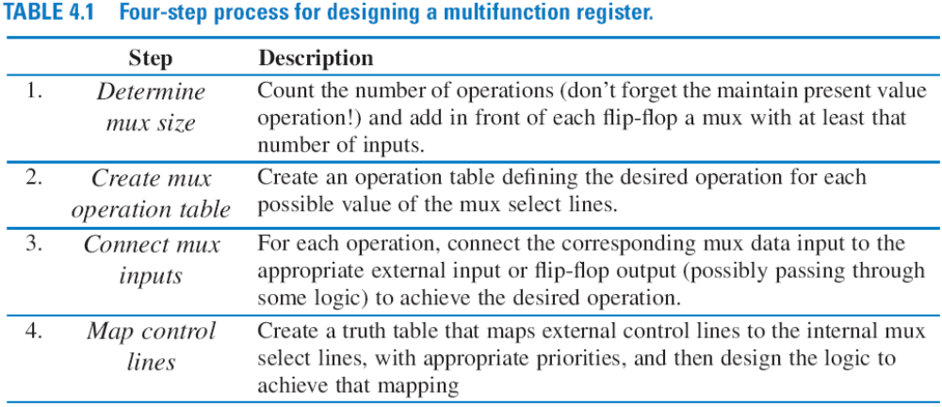
Register Design Process
Can design register with desired operations using simple four-step process

Slide 21
Register Design Example
s2
s1
s0
Operation
Desired register operations
  Load, shift left, synchronous clear, synchronous set
0
0
0
Maintain present value
0
0
1
Parallel load
0
1
0
Shift left
0
1
1
Synchronous clear
1
0
0
Synchronous set
Step 1: Determine mux size
1
0
1
Maintain present value
1
1
0
Maintain present value
1
1
1
Maintain present value
5 operations: above, plus maintain present value (don’t forget this one!) --> Use 8x1 mux
In
1
0
from
a
Qn-1
s2
7
6
5
4
3
2
1
0
s1
Step 2: Create mux operation table
s0
D
Step 3: Connect mux inputs
Q
Step 4: Map control lines
Qn
Inputs
Outputs
s2 = clr’*set
s1 = clr’*set’*ld’*shl + clr
s0 = clr’*set’*ld + clr
clr
set
ld
shl
s2
s1
s0
Operation
0
0
0
0
0
0
0
Maintain present value
0
0
0
1
0
1
0
Shift left
0
0
1
X
0
0
1
Parallel load
0
1
X
X
1
0
0
Set to all 1s
1
X
X
X
0
1
1
Clear to all 0s
a

Slide 22
Register Design Example
I
3
I
2
I
1
I
0
shl
s2
I
3
I
2
I
1
I
0
ld
combi-
s1
shl_in
shl_in
national
s0
set
circuit
Q3
Q2
Q1
Q0
clr
Q3
Q2
Q1
Q0
Step 4: Map control lines
Inputs
Outputs
s2 = clr’*set
s1 = clr’*set’*ld’*shl + clr
s0 = clr’*set’*ld + clr
clr
set
ld
shl
s2
s1
s0
Operation
0
0
0
0
0
0
0
Maintain present value
0
0
0
1
0
1
0
Shift left
0
0
1
X
0
0
1
Parallel load
0
1
X
X
1
0
0
Set to all 1s
1
X
X
X
0
1
1
Clear to all 0s

Slide 23
Adders
4.3
Adds two N-bit binary numbers
  2-bit adder: adds two 2-bit numbers, outputs 3-bit result
  e.g., 01 + 11 = 100 (1 + 3 = 4)
Can design using combinational design process of Ch 2, but doesn’t work well for reasonable-size N
  Why not?
Inputs
Outputs
a1
a0
b1
b0
c
s1
s0
0
0
0
0
0
0
0
0
0
0
1
0
0
1
0
0
1
0
0
1
0
0
0
1
1
0
1
1
0
1
0
0
0
0
1
0
1
0
1
0
1
0
0
1
1
0
0
1
1
0
1
1
1
1
0
0
1
0
0
0
0
1
0
1
0
0
1
0
1
1
1
0
1
0
1
0
0
1
0
1
1
1
0
1
1
1
0
0
0
1
1
1
1
0
1
1
0
0
1
1
1
0
1
0
1
1
1
1
1
1
1
0

Slide 24
Why Adders Aren’t Built Using Standard Combinational Design Process
4.3
Truth table too big
  2-bit adder’s truth table shown
    Has 2⁽²⁺²⁾ = 16 rows
  8-bit adder: 2⁽⁸⁺⁸⁾ = 65,536 rows
  16-bit adder: 2⁽¹⁶⁺¹⁶⁾ = ~4 billion rows
  32-bit adder: ...
Big truth table with numerous 1s/0s yields big logic
  Plot shows number of transistors for N-bit adders, using state-of-the-art automated combinational design tool
Inputs
Outputs
a1
a0
b1
b0
c
s1
s0
0
0
0
0
0
0
0
0
0
0
1
0
0
1
0
0
1
0
0
1
0
0
0
1
1
0
1
1
0
1
0
0
0
0
1
0
1
0
1
0
1
0
0
1
1
0
0
1
1
0
1
1
1
1
0
0
1
0
0
0
0
1
0
1
0
0
1
0
1
1
1
0
1
0
1
0
0
1
0
1
1
1
0
1
1
1
0
0
0
1
1
1
1
0
1
1
0
0
1
1
1
0
1
0
1
1
1
1
1
1
1
0
10000
Q: Predict number of transistors for 16-bit adder
8000
A: 1000 transistors for N=5, doubles for each increase of N. So transistors = 1000*2^{(N-5)}. Thus, for N=16, transistors = 1000*2⁽¹⁶⁻⁵⁾ = 1000*2048 = 2,048,000. Way too many!
ors
6000
t
Transistors
4000
ansis
a
r
T
2000
0
1
2
3
4
5
6
7
8
N

Slide 25
Alternative Method to Design an Adder: Imitate Adding by Hand
Alternative adder design: mimic how people do addition by hand
One column at a time
  Compute sum, add carry to next column
0
1
0
1
1
1
A:
1 1 1 1
1 1 1 1
1 1 1 1
1 1 1 1
B:
+ 0 1 1 0
+ 0 1 1 0
+ 0 1 1 0
+ 0 1 1 0
a
1
0
1
1
0
1
1
0
1
0
1

Slide 26
Alternative Method to Design an Adder: Imitate Adding by Hand
Create component for each column
  Adds that column’s bits, generates sum and carry bits
1
1
0
A:
1 1 1 1
B:
+ 0 1 1 0
a
1
0
1
0
1
1
1
0
A:
1
1
1
1
+
B:
0
1
1
0
b
a
ci
b
a
ci
b
a
ci
b
a
c
o
s
c
o
s
c
o
s
c
o
s
1
0
1
0
1
SUM
Full-adders
Half-adder

Slide 27
Half-Adder
Half-adder: Adds 2 bits, generates sum and carry
Design using combinational design process from Ch 2
1
1
0
A:
1
1
1
1
+
B:
0
1
1
0
nputs
b
a
ci
b
a
ci
b
a
ci
b
a
I
O
utputs
c
o
s
c
o
s
c
o
s
c
o
s
a
b
c
o
s
1
Step 1: Capture the function
0
0
0
0
0
1
0
1
SUM
0
1
0
1
1
0
0
1
1
1
1
0
Step 2: Convert to equations
co = ab
s = a’b + ab’ (same as s = a xor b)
a
b
a
b
Step 3: Create the circuit
Half-adder
c
o
s
c
o
s

Slide 28
Full-Adder
Full-adder: Adds 3 bits, generates sum and carry
Design using combinational design process from Ch 2
1
1
0
A:
1
1
1
1
+
B:
0
1
1
0
b
a
ci
b
a
ci
b
a
ci
b
a
c
o
s
c
o
s
c
o
s
c
o
s
1
0
1
0
1
SUM
Step 1: Capture the function
Step 2: Convert to equations
Step 3: Create the circuit
nputs
I
O
utputs
a
b
ci
a
b
ci
c
o
s
co = a’bc + ab’c + abc’ + abc
co = a’bc +abc +ab’c +abc +abc’ +abc
co = (a’+a)bc + (b’+b)ac + (c’+c)ab
co = bc + ac + ab
s = a’b’c + a’bc’ + ab’c’ + abc
s = a’(b’c + bc’) + a(b’c’ + bc)
s = a’(b xor c)’ + a(b xor c)
s = a xor b xor c
0
0
0
0
0
0
0
1
0
1
0
1
0
0
1
0
1
1
1
0
1
0
0
0
1
1
0
1
1
0
1
1
0
1
0
Full adder
1
1
1
1
1
c
o
s

Slide 29
Carry-Ripple Adder
Using half-adder and full-adders, we can build adder that adds like we would by hand
Called a carry-ripple adder
  4-bit adder shown: Adds two 4-bit numbers, generates 5-bit output
    5-bit output can be considered 4-bit “sum” plus 1-bit “carry out”
  Can easily build any size adder
a3
b3
a2
b2
a1
b1
a0
b0
a
b
ci
a
b
ci
a
b
ci
a
b
a3
a2
a1
a0
b3
b2
b1
b0
F
A
F
A
F
A
HA
4-bit adder
c
o
s
c
o
s
c
o
s
c
o
s
c
o
s3
s2
s1
s0
c
o
s3
s2
s1
s0
(
a
)
(
b
)

Slide 30
Carry-Ripple Adder
Using full-adder instead of half-adder for first bit, we can include a “carry in” bit in the addition
  Will be useful later when we connect smaller adders to form bigger adders
a3
b3
a2
b2
a1
b1
a0
b0
ci
a
b
ci
a
b
ci
a
b
ci
a
b
ci
a3
a2
a1
a0
b3
b2
b1
b0
F
A
F
A
F
A
F
A
4-bit adder
ci
c
o
s
c
o
s
c
o
s
c
o
s
c
o
s3
s2
s1
s0
c
o
s3
s2
s1
s0
(
a
)
(
b
)

Slide 31
Carry-Ripple Adder’s Behavior
0
0
0
0
0
0
0
0
0
0
0
0
a
b
ci
a
b
ci
a
b
ci
a
b
ci
F
A
F
A
F
A
F
A
Assume all inputs initially 0
c
o
s
c
o
s
c
o
s
c
o
s
0
0
0
0
0
0
0
0
0
0
0
1
0
0
1
0
0
1
1
0
0111+0001
(answer should be 01000)
a
b
ci
a
b
ci
a
b
ci
a
b
ci
a
F
A
F
A
F
A
F
A
c
o
s
c
o
s
c
o
s
c
o
s
0
0
1
0
0
0
c
o2
1
c
o1
1
c
o0
0
O
utput a
f
t
er 2 ns (1
F
A del
a
y)
Wrong answer -- something wrong? No -- just need more time for carry to ripple through the chain of full adders.

Slide 32
Carry-Ripple Adder’s Behavior
0
0
0
1
0
0
1
0
1
1
1
0
0111+0001
(answer should be 01000)
a
b
ci
a
b
ci
a
b
ci
a
b
ci
F
A
F
A
F
A
F
A
c
o
s
c
o
s
c
o
s
c
o
s
0
1
1
0
0
1
c
o1
0
0
Outputs after 4ns (2 FA delays)
(
b
)
0
0
1
0
1
1
0
1
1
0
0
1
0
a
b
ci
a
b
ci
a
b
ci
a
b
ci
F
A
F
A
F
A
F
A
c
o
s
c
o
s
c
o
s
c
o
s
1
1
1
a
0
0
c
o2
0
0
0
Outputs after 6ns (3 FA delays)
(
c
)
0
0
1
1
0
1
1
0
1
1
1
0
0
a
b
ci
a
b
ci
a
b
ci
a
b
ci
F
A
F
A
F
A
F
A
c
o
s
c
o
s
c
o
s
c
o
s
1
1
1
0
1
0
(
d
)
0
0
Output after 8ns (4 FA delays)
Correct answer appears after 4 FA delays

Slide 33
Cascading Adders
a7
a6
a5
a4
b7
b6
b5
b4
a3
a2
a1
a0
b3
b2
b1
b0
a3
a2
a1
a0
b3
b2
b1
b0
a3
a2
a1
a0
b3
b2
b1
b0
a7.. a0
b7.. b0
4-bit adder
ci
4-bit adder
ci
8-bit adder
ci
c
o
s3
s2
s1
s0
c
o
s3
s2
s1
s0
c
o
s7.. s0
c
o
s7
s6
s5
s4
s3
s2
s1
s0
(
a
)
(
b
)

Slide 34
Adder Example: DIP-Switch-Based Adding Calculator
Goal: Create calculator that adds two 8-bit binary numbers, specified using DIP switches
  DIP switch: Dual-inline package switch, move each switch up or down
  Solution: Use 8-bit adder
DIP switches
1
0
a7..a0
b7..b0
ci
0
a
8-bit carry-ripple adder
c
o
s7..s0
C
A
L
C
LEDs

Slide 35
Adder Example: DIP-Switch-Based Adding Calculator
To prevent spurious values from appearing at output, can place register at output
  Actually, the light flickers from spurious values would be too fast for humans to detect -- but the principle of registering outputs to avoid spurious values being read by external devices (which normally aren’t humans) applies here.
DIP switches
1
0
a7..a0
b7..b0
8-bit adder
ci
0
c
o
s7..s0
e
ld
clk
8-bit register
C
A
L
C
LEDs

Slide 36
Adder Example: Compensating Weight Scale
Weight scale with compensation amount of 0-7
  To compensate for inaccurate sensor due to physical wear
  Use 8-bit adder
7
0
1
weight
sensor
6
2
5
4
3
01000010
000
0
0
0
0
0
010
a7..a0
b7..b0
8-bit adder
ci
0
a
c
o
s7..s0
1
ld
01000010
01000100
Weight
clk
display register
Adjuster
to display

Slide 37
Shifters
4.4
Shifting (e.g., left shifting 0011 yields 0110) useful for:
  Manipulating bits
  Converting serial data to parallel (remember earlier above-mirror display example with shift registers)
  Shift left once is same as multiplying by 2 (0011 (3) becomes 0110 (6))
    Why? Essentially appending a 0 -- Note that multiplying decimal number by 10 accomplished just be appending 0, i.e., by shifting left (55 becomes 550)
  Shift right once same as dividing by 2
i3
i2
i1
i0
i3
i2
i1
i0
i3
i2
i1
i0
inR
inL
in
2
0
1
2
0
1
2
0
1
2
0
1
shL
s0
in
0
1
0
1
0
1
0
1
shR
s1
sh
a
<<1
q3
q2
q1
q0
q3
q2
q1
q0
Symbol
Left shifter
Shifter with left shift, right shift, and no shift
q3
q2
q1
q0
Shifter with left shift or no shift
(
a
)

Slide 38
Shifter Example: Approximate Celsius to Fahrenheit Converter
Convert 8-bit Celsius input to 8-bit Fahrenheit output
  F = C * 9/5 + 32
  Approximate: F = C*2 + 32
  Use left shift: F = left_shift(C) + 32
C
* 2
00001100 (12)
8
<<1
0 (shift in 0)
00100000 (32)
a
00011000 (24)
8
8
8-bit adder
00111000 (56)
8
F

Slide 39
Shifter Example: Temperature Averager
Four registers storing a history of temperatures
Want to output the average of those temperatures
Add, then divide by four
  Same as shift right by 2
  Use three adders, and right shift by two
0000111 (7)
001000 (8)
001100 (12)
001111 (15)
T
Ra
Rb
Rc
Rd
clk
ld
ld
+
+
+
shift in 0
0101010 (42)
divide by 4
0
>>2
0001010 (10)
a
ld
Ravg
Tavg

Slide 40
Barrel Shifter
i3
i2
i1
i0
A shifter that can shift by any amount
  4-bit barrel left shift can shift left by 0, 1, 2, or 3 positions
  8-bit barrel left shifter can shift left by 0, 1, 2, 3, 4, 5, 6, or 7 positions
    (Shifting an 8-bit number by 8 positions is pointless -- you just lose all the bits)
Could design using 8x1 muxes and lots of wires
  Too many wires
More elegant design
  Chain three shifters: 4, 2, and 1
  Can achieve any shift of 0..7 by enabling the correct combination of those three shifters, i.e., shifts should sum to desired amount
in
0
1
0
1
0
1
0
1
sh
q3
q2
q1
q0
Shift by 1 shifter uses 2x1 muxes. 8x1 mux solution for 8-bit barrel shifter: too many wires.
Q: xyz=??? to shift by 5?
I
8
00000110
1
x
sh
<<4
in
0
8
01100000 (by 4)
0
a
y
sh
<<2
in
0
1
8
01100000
z
sh
<<1
in
0
Net result: shift by 5:
11000000 (by 1)
8
Q

Slide 41
Comparators
4.5
N-bit equality comparator: Outputs 1 if two N-bit numbers are equal
  4-bit equality comparator with inputs A and B
    a3 must equal b3, a2 = b2, a1 = b1, a0 = b0
      Two bits are equal if both 1, or both 0
      eq = (a3b3 + a3’b3’) * (a2b2 + a2’b2’) * (a1b1 + a1’b1’) * (a0b0 + a0’b0’)
    Recall that XNOR outputs 1 if its two input bits are the same
      eq = (a3 xnor b3) * (a2 xnor b2) * (a1 xnor b1) * (a0 xnor b0)
0110 = 0111 ?
a3
b3
a2
b2
a1
b1
a0
b0
0
0
1
1
1
1
0
1
1
1
1
0
a3
a2
a1
a0
b3
b2
b1
b0
a
4-bit equality comparator
eq
(
b
)
0
eq
(
a
)

Slide 42
Magnitude Comparator
N-bit magnitude comparator: Indicates whether A>B, A=B, or A<B, for its two N-bit inputs A and B
  How design? Consider how compare by hand. First compare a3 and b3. If equal, compare a2 and b2. And so on. Stop if comparison not equal -- whichever’s bit is 1 is greater. If never see unequal bit pair, A=B.
A=1011
B=1001
1011
1001
Equal
1011
1001
Equal
1011
1001
Unequal
So A > B
a

Slide 43
Magnitude Comparator
By-hand example leads to idea for design
  Start at left, compare each bit pair, pass results to the right
  Each bit pair called a stage
  Each stage has 3 inputs indicating results of higher stage, passes results to lower stage
a3
b3
a2
b2
a1
b1
a0
b0
a
b
a
b
a
b
a
b
Igt
in_gt
out_gt
in_gt
out_gt
in_gt
out_gt
in_gt
out_gt
AgtB
Ieq
in_eq
out_eq
in_eq
out_eq
in_eq
out_eq
in_eq
out_eq
AeqB
Ilt
in_lt
out_lt
in_lt
out_lt
in_lt
out_lt
in_lt
out_lt
AltB
Stage 3
Stage 2
Stage 1
Stage 0
(
a
)
0
Igt
a3
a2
a1
a0
b3
b2
b1
b0
AgtB
1
Ieq
4-bit magnitude comparator
AeqB
0
Ilt
AltB
(
b
)

Slide 44
Magnitude Comparator
a3
b3
a2
b2
a1
b1
a0
b0
a
b
a
b
a
b
a
b
Igt
in_gt
out_gt
in_gt
out_gt
in_gt
out_gt
in_gt
out_gt
AgtB
Ieq
in_eq
out_eq
in_eq
out_eq
in_eq
out_eq
in_eq
out_eq
AeqB
Ilt
in_lt
out_lt
in_lt
out_lt
in_lt
out_lt
in_lt
out_lt
AltB
Stage 3
Stage 2
Stage 1
Stage 0
Each stage:
  out_gt = in_gt + (in_eq * a * b’)
    A>B (so far) if already determined in higher stage, or if higher stages equal but in this stage a=1 and b=0
  out_lt = in_lt + (in_eq * a’ * b)
    A<B (so far) if already determined in higher stage, or if higher stages equal but in this stage a=0 and b=1
  out_eq = in_eq * (a XNOR b)
    A=B (so far) if already determined in higher stage and in this stage a=b too
  Simple circuit inside each stage, just a few gates (not shown)

Slide 45
Magnitude Comparator
How does it work?
1011 = 1001 ?
1
=
1
0
0
1
0
1
1
a3
b3
a2
b2
a1
b1
a0
b0
a
b
a
b
a
b
a
b
Igt
0
in_gt
out_gt
0
in_gt
out_gt
in_gt
out_gt
in_gt
out_gt
A
gtB
Ieq=1 causes this stage to compare
Ieq
1
1
0
in_eq
out_eq
0
in_eq
out_eq
in_eq
out_eq
in_eq
out_eq
A
eqB
I
lt
in_lt
out_lt
in_lt
out_lt
in_lt
out_lt
in_lt
out_lt
A
ltB
S
tage3
S
tage2
S
tage1
S
tage0
(
a
)
a
1
1
0
=
0
1
0
1
1
a3
b3
a2
b2
a1
b1
a0
b0
a
b
a
b
a
b
a
b
Igt
0
in_gt
out_gt
in_gt
out_gt
0
in_gt
out_gt
in_gt
out_gt
A
gtB
Ieq
1
in_eq
out_eq
in_eq
out_eq
1
in_eq
out_eq
in_eq
out_eq
A
eqB
I
lt
0
in_lt
out_lt
in_lt
out_lt
0
in_lt
out_lt
in_lt
out_lt
A
ltB
S
tage3
S
tage2
S
tage1
S
tage0
(
b
)

Slide 46
Magnitude Comparator
1011 = 1001 ?
1
1
0
0
1
>
0
1
1
a3
b3
a2
b2
a1
b1
a0
b0
Final answer appears on the right
Takes time for answer to “ripple” from left to right
Thus called “carry-ripple style” after the carry-ripple adder
  Even though there’s no “carry” involved
a
b
a
b
a
b
a
b
Igt
0
in_gt
out_gt
in_gt
out_gt
in_gt
out_gt
1
in_gt
out_gt
A
gtB
Ieq
1
in_eq
out_eq
in_eq
out_eq
in_eq
out_eq
0
in_eq
out_eq
A
eqB
I
lt
0
in_lt
out_lt
in_lt
out_lt
in_lt
out_lt
0
in_lt
out_lt
A
ltB
S
tage3
S
tage2
S
tage1
S
tage0
(
c
)
a
1
1
0
0
1
0
1
1
a3
b3
a2
b2
a1
b1
a0
b0
a
b
a
b
a
b
a
b
Igt
0
in_gt
out_gt
in_gt
out_gt
in_gt
out_gt
in_gt
out_gt
1
A
gtB
Ieq
1
in_eq
out_eq
in_eq
out_eq
in_eq
out_eq
in_eq
out_eq
0
A
eqB
I
lt
0
in_lt
out_lt
in_lt
out_lt
in_lt
out_lt
in_lt
out_lt
0
A
ltB
S
tage3
S
tage2
S
tage1
S
tage0
(
d
)

Slide 47
Magnitude Comparator Example:
Minimum of Two Numbers
Design a combinational component that computes the minimum of two 8-bit numbers
  Solution: Use 8-bit magnitude comparator and 8-bit 2x1 mux
    If A<B, pass A through mux. Else, pass B.
11000000
01111111
MIN
A
B
8
8
a
8
8
8
8
A
B
A
B
1
I
1
I
0
M
in
0
Igt
AgtB
0
s
C
1
Ieq
8-bit magnitude comparator
AeqB
8-bit
0
Ilt
AltB
0
2x1 mux
8
8
(
b
)
C
(
a
)
01111111

Slide 48
Counters
4.6
N-bit up-counter: N-bit register that can increment (add 1) to its own value on each clock cycle
  0000, 0001, 0010, 0011, ...., 1110, 1111, 0000
  Note how count “rolls over” from 1111 to 0000
    Terminal (last) count, tc, equals1 during value just before rollover
Internal design
  Register, incrementer, and N-input AND gate to detect terminal count
0
1
c
n
t
4-bit up-counter
a
t
c
C
4
0
0000
0001
0010
0011
0100
1
0101
0
1111
0000
1110
0001
...
4-bit up-counter
c
n
t
ld
4-bit register
a
4
4
4
+1
4
t
c
C

Slide 49
Incrementer
Counter design used incrementer
Incrementer design
  Could use carry-ripple adder with B input set to 00...001
    But when adding 00...001 to another number, the leading 0’s obviously don’t need to be considered -- so just two bits being added per column
  Use half-adders (adds two bits) rather than full-adders (adds three bits)
a3
a2
a1
a0
1
carries:
0 1 1
0 0 1 1
a
b
a
b
a
b
a
b
a3
a2
a1
a0
unused
HA
HA
HA
HA
t
+1
+
1
n
c
o
s3
s2
s1
s0
c
o
s
c
o
s
c
o
s
c
o
s
0
0
1
0
0
r
c
o
s3
s2
s1
s0
I
(
b
)
(
a
)

Slide 50
Incrementer
Can build faster incrementer using combinational logic design process
  Capture truth table
  Derive equation for each output
    c0 = a3a2a1a0
    ...
    s0 = a0’
  Results in small and fast circuit
  Note: works for small N -- larger N leads to exponential growth, like for N-bit adder
nputs
I
O
utputs
a3
a2
a1
a0
c0
s3
s2
s1
s0
0
0
0
0
0
0
0
0
1
0
0
0
1
0
0
0
1
0
0
0
1
0
0
0
0
1
1
0
0
1
1
0
0
1
0
0
0
1
0
0
0
0
1
0
1
0
1
0
1
0
0
1
1
0
0
1
1
0
0
0
1
1
1
0
1
1
1
0
1
0
0
0
1
0
0
0
0
1
0
0
1
1
0
0
1
0
1
0
1
0
1
0
1
0
0
1
0
1
1
1
0
1
1
0
1
1
0
0
1
1
0
0
0
1
1
0
1
1
1
0
1
0
1
1
1
0
1
1
1
0
0
1
1
1
1
1
1
1
1
1
0
0
0
0

Slide 51
Counter Example: Mode in Above-Mirror Display
Recall above-mirror display example from Chapter 2
  Assumed component that incremented xy input each time button pressed: 00, 01, 10, 11, 00, 01, 10, 11, 00, ...
  Can use 2-bit up-counter
    Assumes mode=1 for just one clock cycle during each button press
      Recall “Button press synchronizer” example from Chapter 3
mode
c
n
t
2-bit up
c
ou
n
t
er
clk
t
c
c1
c0
x
y

Slide 52
Counter Example: 1 Hz Pulse Generator Using 256 Hz Oscillator
Suppose have 256 Hz oscillator, but want 1 Hz pulse
  1 Hz is 1 pulse per second -- useful for keeping time
  Design using 8-bit up-counter, use tc output as pulse
    Counts from 0 to 255 (256 counts), so pulses tc every 256 cycles
1
c
n
t
8-bit up-counter
osc
t
c
C
(256 Hz)
8
p
(unused)
(1 Hz)

Slide 53
Down-Counter
4-bit down-counter
  1111, 1110, 1101, 1100, …, 0011, 0010, 0001, 0000, 1111, …
  Terminal count is 0000
    Use NOR gate to detect
  Need decrementer (-1) – design like designed incrementer
4-bit down-counter
c
n
t
ld
4-bit register
4
4
4
–1
t
c
C
4

Slide 54
Up/Down-Counter
Can count either up or down
  Includes both incrementer and decrementer
  Use dir input to select, using 2x1: dir=0 means up
  Likewise, dir selects appropriate terminal count value
4-bit up/down counter
dir
1
4-bit 2
x
1
0
4
clr
clr
c
n
t
ld
4-bit register
4
4
4
4
4
–1
+1
4
4
1
2
x
1
0
t
c
C

Slide 55
Counter Example: Light Sequencer
Illuminate 8 lights from right to left, one at a time, one per second
Use 3-bit up-counter to counter from 0 to 7
Use 3x8 decoder to illuminate appropriate light
Note: Used 3-bit counter with 3x8 decoder
  NOT an 8-bit counter – why not?
1
c
n
t
3-bit u
p
-
c
ou
n
t
er
clk
t
c
c2
c1
c0
(1
H
z)
0
0
0
0
0
1
0
1
0
unused
3
x
8 d
c
d
i2
i1
i0
d7
d6
d5
d4
d3
d2
d1
d0
a
lig
h
ts

Slide 56
Counter with Parallel Load
Up-counter that can be loaded with external value
  Designed using 2x1 mux – ld input selects incremented value or external value
  Load the internal register when loading external value or when counting
L
4
ld
x
1
4-bit 2
1
0
4
c
n
t
ld
4-bit register
4
4
4
+1
t
c
C

Slide 57
Counter with Parallel Load
1000
Useful to create pulses at specific multiples of clock
  Not just at N-bit counter’s natural wrap-around of 2^{N}
Example: Pulse every 9 clock cycles
  Use 4-bit down-counter with parallel load
  Set parallel load input to 8 (1000)
  Use terminal count to reload
    When count reaches 0, next cycle loads 8.
  Why load 8 and not 9? Because 0 is included in count sequence:
    8, 7, 6, 5, 4, 3, 2, 1, 0 → 9 counts
4
ld
L
1
4-bit down-counter
c
n
t
t
c
C
clk
4

Slide 58
Counter Example:
New Year’s Eve Countdown Display
Chapter 2 example previously used microprocessor to counter from 59 down to 0 in binary
Can use 8-bit (or 7- or 6-bit) down-counter instead, initially loaded with 59
Happy
d0
0
New
59
8
c0
i0
Year
L
d1
c1
i1
1
c2
i2
d2
2
ld
c3
i3
d3
3
reset
c4
i4
c5
i5
d58
c
n
t
c6
d59
countdown
c7
d60
d61
58
clk
8-bit
d62
59
fireworks
(1 Hz)
down-
t
c
6x64
d63
counter
dcd

Slide 59
Counter Example:
1 Hz Pulse Generator from 60 Hz Clock
U.S. electricity standard uses 60 Hz signal
  Device may convert that to 1 Hz signal to count seconds
Use 6-bit up-counter
  Can count from 0 to 63
  Create simple logic to detect 59 (for 60 counts)
    Use to clear the counter back to 0 (or to load 0)
clr
1
c
n
t
6-bit up counter
osc
t
c
C
(60 Hz)
p
(1 Hz)

Slide 60
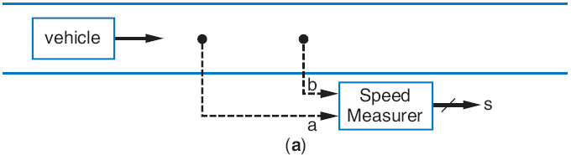
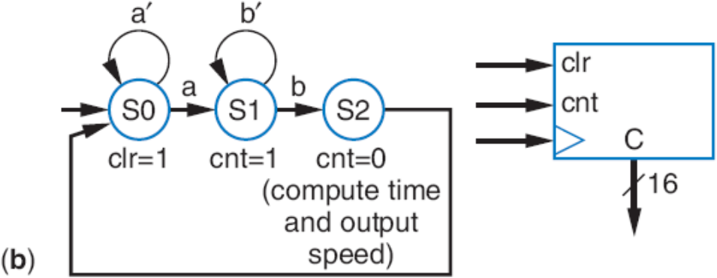
Timer
A type of counter used to measure time
  If we know the counter’s clock frequency and the count, we know the time that’s been counted
Example: Compute car’s speed using two sensors
  First sensor (a) clears and starts timer
  Second sensor (b) stops timer
  Assuming clock of 1kHz, timer output represents time to travel between sensors. Knowing the distance, we can compute speed

Slide 61
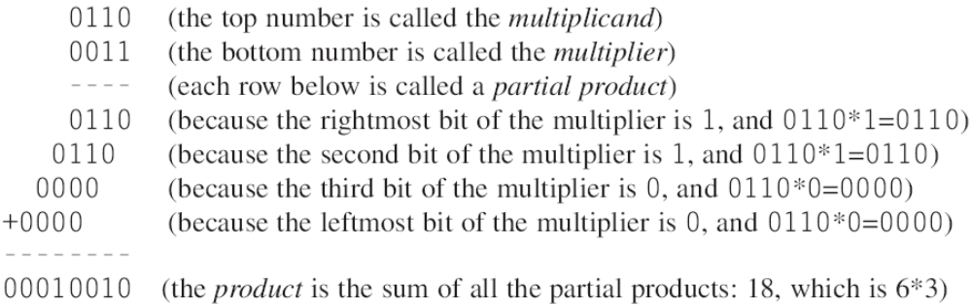
Multiplier – Array Style
4.7
Can build multiplier that mimics multiplication by hand
  Notice that multiplying multiplicand by 1 is same as ANDing with 1

Slide 62
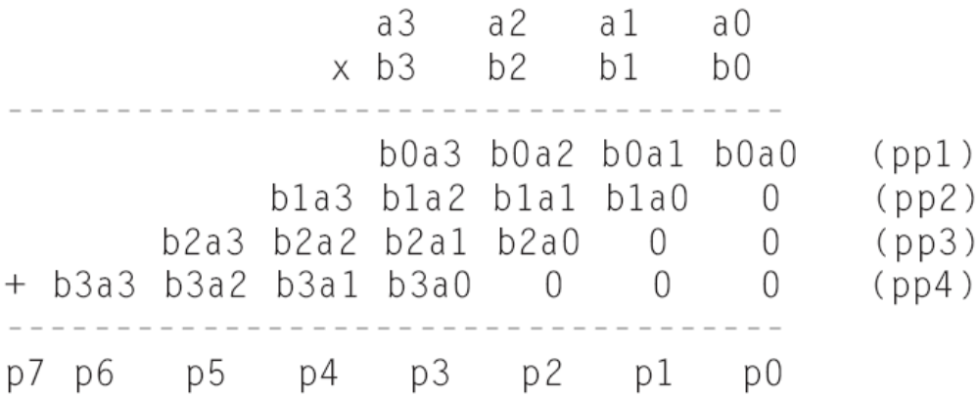
Multiplier – Array Style
Generalized representation of multiplication by hand

Slide 63
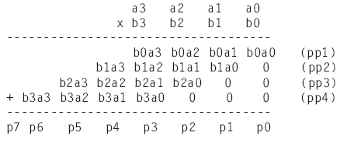
Multiplier – Array Style
Multiplier design – array of AND gates
a3
a2
a1
a0
b0
pp1
b1
pp2
0
0
b2
+ (5-bit)
pp3
0
0
b3
A
B
+ (6-bit)
*
pp4
P
0
0
0
+ (7-bit)
Block symbol
p7..p0

Slide 64
Subtractor
4.8
Can build subtractor as we built carry-ripple adder
  Mimic subtraction by hand
  Compute borrows from columns on left
    Use full-subtractor component:
      wi is borrow by column on right, wo borrow from column on left
1st
c
olumn
2nd
c
olumn
3
r
d
c
olumn
4th
c
olumn
0
0
1
1
0
0
1
0
1
0
1
1
0
1
10
1
0
1
10
1
0
1
0
1
0
-
0
1
1
1
-
0
1
1
1
-
0
1
1
1
-
0
1
1
1
1
1
1
0
1
1
0
0
1
1
a3
b3
a2
b2
a1
b1
a0
b0
wi
a
b
wi
a
b
wi
a
b
wi
a
b
wi
a3
a2
a1
a0
b3
b2
b1
b0
FS
FS
FS
FS
4-bit subtractor
wi
a
w
o
s
w
o
s
w
o
s
w
o
s
w
o
s3
s2
s1
s0
w
o
s3
s2
s1
s0
(
b
)
(
c
)

Slide 65
Subtractor Example: DIP-Switch Based Adding/Subtracting Calculator
Extend earlier calculator example
  Switch f indicates whether want to add (f=0) or subtract (f=1)
  Use subtractor and 2x1 mux
DIP switches
1
0
8
8
8
8
A
B
ci
0
A
B
wi
0
8-bit adder
8-bit subtractor
co
S
wo
S
1
f
8
x
8
0
0
2
1
1
8
e
ld
8-bit register
clk
CALC
8
LEDs

Slide 66
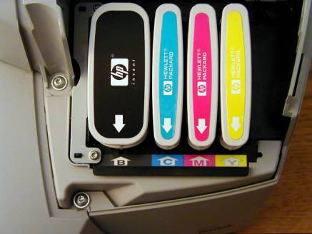
Subtractor Example:
Color Space Converter – RGB to CMYK
Color
  Often represented as weights of three colors: red, green, and blue (RGB)
    Perhaps 8 bits each, so specific color is 24 bits
      White: R=11111111, G=11111111, B=11111111
      Black: R=00000000, G=00000000, B=00000000
      Other colors: values in between, e.g., R=00111111, G=00000000, B=00001111 would be a reddish purple
  Good for computer monitors, which mix red, green, and blue lights to form all colors
Printers use opposite color scheme
  Because inks absorb light
  Use complementary colors of RGB: Cyan (absorbs red), reflects green and blue, Magenta (absorbs green), and Yellow (absorbs blue)

Slide 67
Subtractor Example:
Color Space Converter – RGB to CMYK
Printers must quickly convert RGB to CMY
  C=255-R, M=255-G, Y=255-B
  Use subtractors as shown
R
G
B
255
8
255
8
255
8
8
8
8
o CMY
-
-
-
t
GB
R
8
8
8
C
M
Y

Slide 68

Subtractor Example:
Color Space Converter – RGB to CMYK
Try to save colored inks
  Expensive
  Imperfect – mixing C, M, Y doesn’t yield good-looking black
Solution: Factor out the black or gray from the color, print that part using black ink
  e.g., CMY of (250,200,200)= (200,200,200) + (50,0,0).
    (200,200,200) is a dark gray – use black ink

Slide 69
Subtractor Example:
Color Space Converter – RGB to CMYK
Call black part K
  (200,200,200): K=200
  (Letter “B” already used for blue)
Compute minimum of C, M, Y values
  Use MIN component designed earlier, using comparator and mux, to compute K
  Output resulting K value, and subtract K value from C, M, and Y values
  Ex: Input of (250,200,200) yields output of (50,0,0,200)
R
8
G
8
B
8
K
Y
R
G
B
o CM
R
GB
t
o CMY
t
C
M
Y
GB
R
8
8
8
8
C
M
Y
MIN
8
MIN
8
K
-
-
-
8
8
8
8
C2
M2
Y2
K

Slide 70
Representing Negative Numbers: Two’s Complement
Negative numbers common
  How represent in binary?
Signed-magnitude
  Use leftmost bit for sign bit
    So -5 would be:
      1101 using four bits
      10000101 using eight bits
Better way: Two’s complement
  Big advantage: Allows us to perform subtraction using addition
  Thus, only need adder component, no need for separate subtractor component!

Slide 71
Ten’s Complement
1
9
Before introducing two’s complement, let’s consider ten’s complement
  But, be aware that computers DO NOT USE TEN’S COMPLEMENT. Introduced for intuition only.
  Complements for each base ten number shown to right – Complement is the number that when added results in 10
2
8
3
7
4
6
5
5
6
4
7
3
8
2
9
1

Slide 72
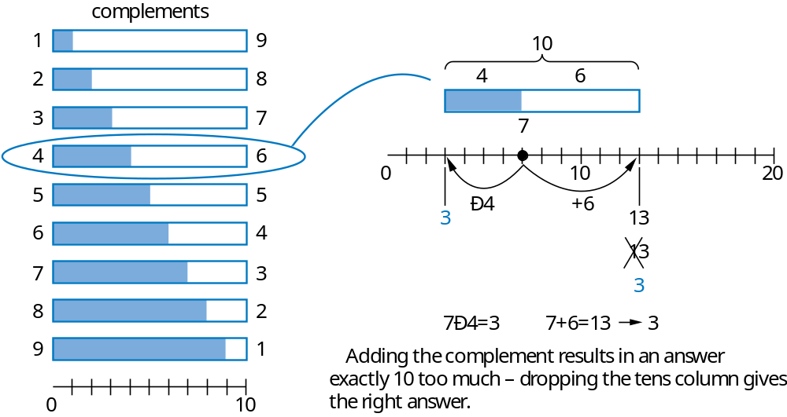
Ten’s Complement
Nice feature of ten’s complement
  Instead of subtracting a number, adding its complement results in answer exactly 10 too much
  So just drop the 1 – results in subtracting using addition only
-
-

Slide 73
Two’s Complement is Easy to Compute:
Just Invert Bits and Add 1
Hold on!
  Sure, adding the ten’s complement achieves subtraction using addition only
  But don’t we have to perform subtraction to have determined the complement in the first place? e.g., we only know that the complement of 4 is 6 by subtracting 10-4=6 in the first place.
True – but in binary, it turns out that the two’s complement can be computed easily
  Two’s complement of 011 is 101, because 011 + 101 is 1000
  Could compute complement of 011 as 1000 – 011 = 101
  Easier method: Just invert all the bits, and add 1
  The complement of 011 is 100+1 = 101 -- it works!
Q: What is the two’s complement of 0101?
A: 1010+1=1011
(check: 0101+1011=10000)
a
Q: What is the two’s complement of 0011?
A: 1100+1=1101

Slide 74
Two’s Complement Subtractor Built with an Adder
Using two’s complement
  A – B = A + (-B)
  = A + (two’s complement of B)
  = A + invert_bits(B) + 1
So build subtractor using adder by inverting B’s bits, and setting carry in to 1
A
B
N-bit
A
B
1
Adder
cin
S

Slide 75
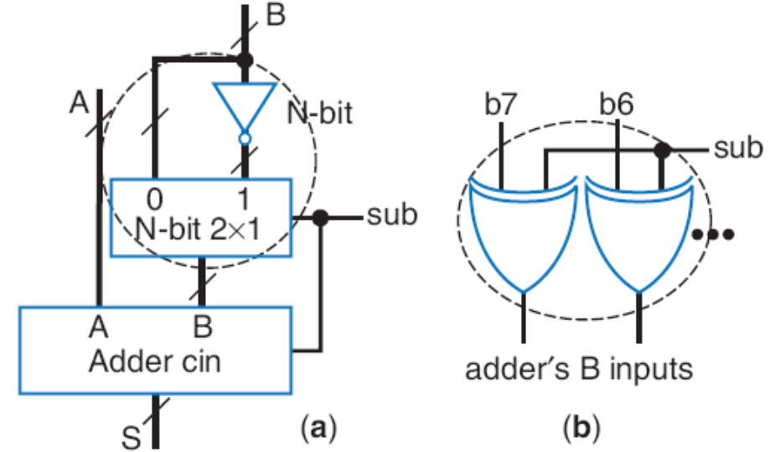
Adder/Subtractor
Adder/subtractor: control input determines whether add or subtract
  Can use 2x1 mux – sub input passes either B or inverted B
  Alternatively, can use XOR gates – if sub input is 0, B’s bits pass through; if sub input is 1, XORs invert B’s bits

Slide 76
Adder/Subtractor Example: Calculator
Previous calculator used separate adder and subtractor
Improve by using adder/subtractor, and two’s complement numbers
DIP switches
1
0
8
8
1
f
A
B
0
sub
8-bit adder/subtractor
S
8
e
ld
clk
8-bit register
C
A
L
C
8
DIP swi
t
ches
1
0
LEDs
8
8
8
8
A
B
ci
0
A
B
wi
0
8-bit adder
8-bit subt
c
o
S
w
o
S
r
a
c
t
or
1
f
8
0
2
x
1
1
8
0
e
8
clk
ld
8-bit
r
e
g
is
t
er
8
C
A
L
C
LEDs

Slide 77
Overflow
Sometimes result can’t be represented with given number of bits
  Either too large magnitude of positive or negative
  e.g., 4-bit two’s complement addition of 0111+0001 (7+1=8). But 4-bit two’s complement can’t represent number >7
    0111+0001 = 1000 WRONG answer, 1000 in two’s complement is -8, not +8
  Adder/subtractor should indicate when overflow has occurred, so result can be discarded

Slide 78
Detecting Overflow: Method 1
Assuming 4-bit two’s complement numbers, can detect overflow by detecting when the two numbers’ sign bits are the same but are different from the result’s sign bit
  If the two numbers’ sign bits are different, overflow is impossible
    Adding a positive and negative can’t exceed largest magnitude positive or negative
Simple circuit
  overflow = a3’b3’s3 + a3b3s3’
  Include “overflow” output bit on adder/subtractor
sign bits
0
1
1
1
1
1
1
1
1
0
0
0
+
0
0
0
1
+
1
0
0
0
+
0
1
1
1
1
0
0
0
0
1
1
1
1
1
1
1
overflow
overflow
no overflow
(
a
)
(
b
)
(
c
)
If the numbers’ sign bits have the same value, which
differs from the result’s sign bit, overflow has occurred.

Slide 79
Detecting Overflow: Method 2
Even simpler method: Detect difference between carry-in to sign bit and carry-out from sign bit
Yields simpler circuit: overflow = c3 xor c4
1
1
1
0
0
0
0
0
0
0
1
1
1
1
1
1
1
1
0
0
0
+
0
0
0
1
+
1
0
0
0
+
0
1
1
1
0
1
0
0
0
1
0
1
1
1
0
1
1
1
1
overflow
overflow
no overflow
(
a
)
(
b
)
(
c
)
If the carry into the sign bit column differs from the
carry out of that column, overflow has occurred.

Slide 80
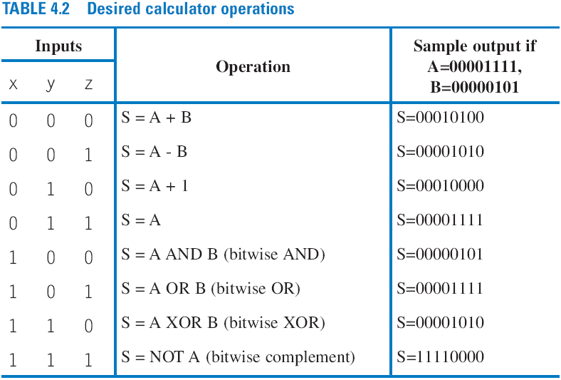
Arithmetic-Logic Unit: ALU
4.9
ALU: Component that can perform any of various arithmetic (add, subtract, increment, etc.) and logic (AND, OR, etc.) operations, based on control inputs
Motivation:
  Suppose want multi-function calculator that not only adds and subtracts, but also increments, ANDs, ORs, XORs, etc.

Slide 81
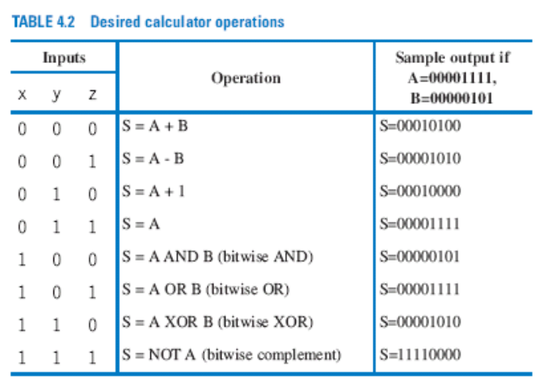
Multifunction Calculator without an ALU
Can build multifunction calculator using separate components for each operation, and muxes
  But too many wires, and wasted power computing all those operations when at any time you only use one of the results
DIP switches
1
0
8
8
A
B
+
Ð
+1
AND
OR
X
OR
N
O
T
Wasted
8
power
8
8
8
8
8
8
8
A lot of wires
1
0
x
0
1
2
3
4
5
6
7
y
s2
8-bit 8
⋅
1
z
s1
s0
e
8
Id
8-bit
r
e
g
is
t
er
clk
C
A
L
C
8
LEDs

Slide 82
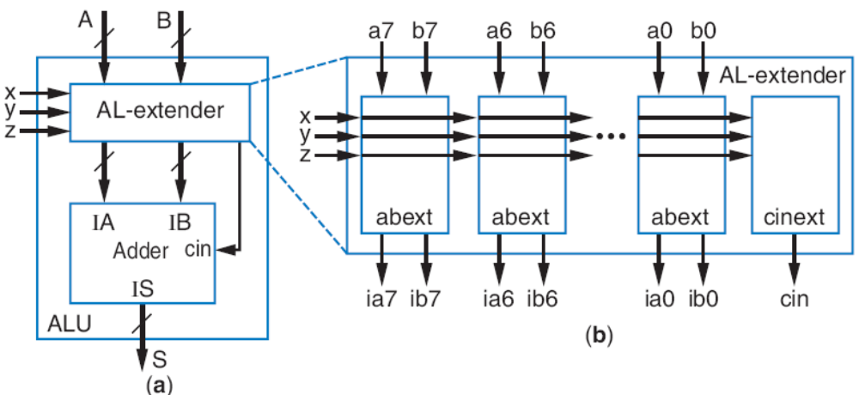
ALU
More efficient design uses ALU
  ALU design not just separate components multiplexed (same problem as previous slide!),
  Instead, ALU design uses single adder, plus logic in front of adder’s A and B inputs
    Logic in front is called an arithmetic-logic extender
  Extender modifies the A and B inputs such that desired operation will appear at output of the adder

Slide 83
Arithmetic-Logic Extender in Front of ALU
xyz=000: Want S=A+B – just pass a to ia, b to ib, and set cin=0
xyz=001: Want S=A-B – pass a to ia, b’ to ib, and set cin=1
xyz=010: Want S=A+1 – pass a to ia, set ib=0, and set cin=1
xyz=011: Want S=A – pass a to ia, set ib=0, and set cin=0
xyz=1000: Want S=A AND B – set ia=a*b, b=0, and cin=0
others: likewise
Based on above, create logic for ia(x,y,z,a,b) and ib(x,y,z,a,b) for each abext, and create logic for cin(x,y,z), to complete design of the AL-extender component

Slide 84
ALU Example: Multifunction Calculator
1
DIP swi
t
ches
0
8
8
A
B
+
Ð
+1
AND
OR
X
OR
N
O
T
W
as
t
ed
8
8
8
8
p
o
w
er
DIP switches
1
0
8
8
8
8
A lot of wi
r
e
s
.
x
s2
0
1
2
3
4
5
6
7
1
1
y
s1
8-bit 8
⋅
1
z
s0
8
0
0
clk
e
Id
8-bit
r
e
g
is
t
er
8
C
A
L
C
8
8
LEDs
A
B
Design using ALU is elegant and efficient
  No mass of wires
  No big waste of power
x
A
B
y
x
ALU
z
y
z
S
8
e
ld
clk
8-bit register
8
C
A
L
C
LEDs

Slide 85
Register Files
4.10
MxN register file component provides efficient access to M N-bit-wide registers
  If we have many registers but only need access one or two at a time, a register file is more efficient
  Ex: Above-mirror display (earlier example), but this time having 16 32-bit registers
    Too many wires, and big mux is too slow
er
32
C
C
a
er
8
s
t
d0
load
r
huge mux
ompu
d0
load
eg0
?
t
r
eg0
T
o the ab
ompu
32
mi
om the car
c
4
⋅
16
⋅
i0
i0
or displ
T
2
4
mi
T
o the ab
c
al
8
r
t
r
r
oo much
or displ
t
om the car's
32-bit
r
al
r
n
8-bit
r
r
F
d1
fanout
t
e
load
r
eg1
A
x
×
16
4
1
r
n
c
4
a0
1
F
e
i0
o
c
i1
a
v
o
y
e
8
a
v
i3-i0
i1
y
e
a1
d2
load
d
d
-
D
D
r
eg2
I
32
8
i2
8
c
ongestion
d15
d3
load
load
r
eg3
M
e
r
e
eg15
load
i15
i3
s1
s0
load
32
8
s3-s0
x
y

Slide 86
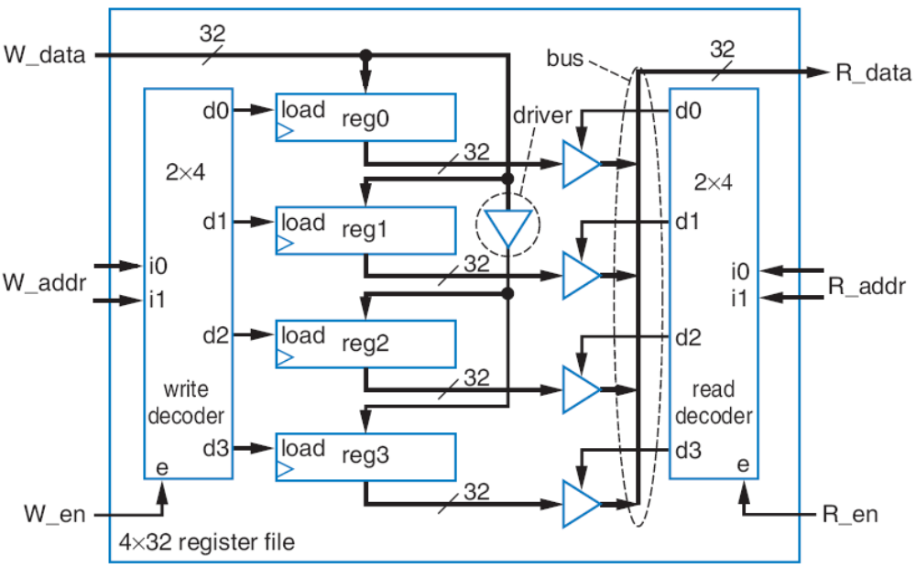
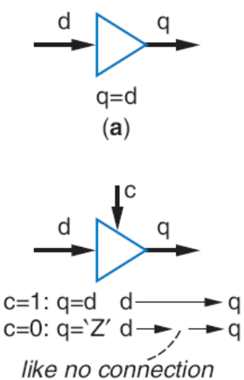
Register File
Instead, want component that has one data input and one data output, and allows us to specify which internal register to write and which to read
32
32
W_data
R_data
a
4
4
W_addr
R_addr
W_en
R_en
16
×
32
register file
a

Slide 87
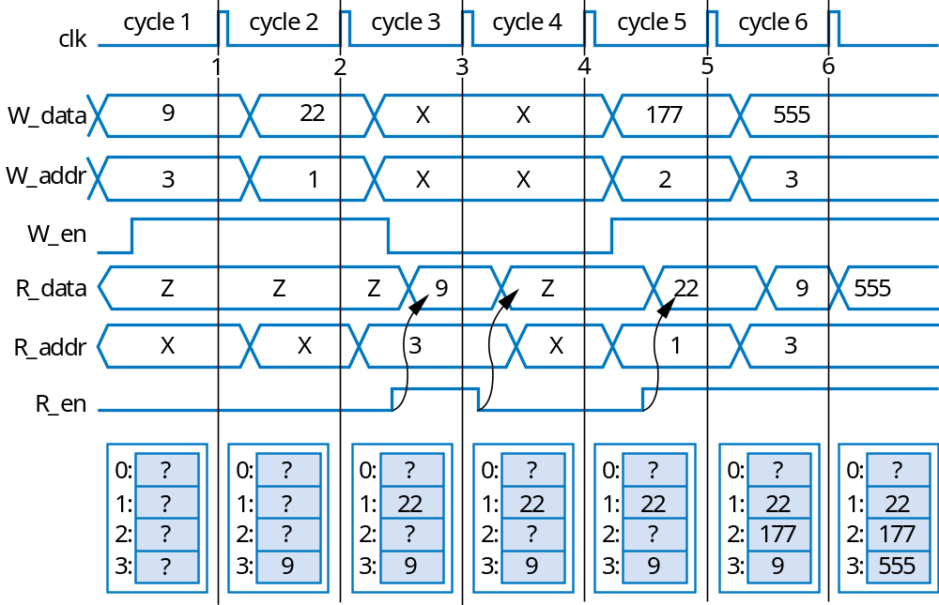
Register File Timing Diagram
Can write one register and read one register each clock cycle
  May be same register
32
32
W_data
R_data
2
W_addr
R_addr
2
W_en
R_en
4x32
register file

Slide 88
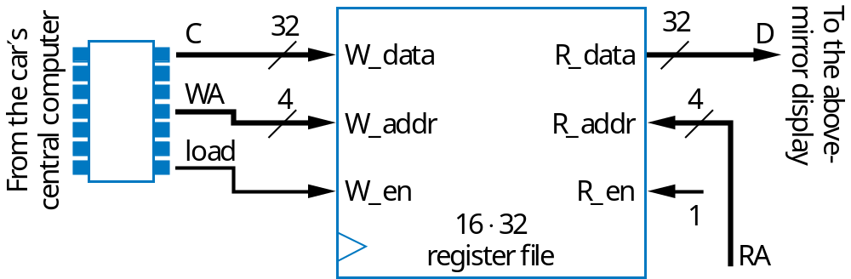
Register-File Example: Above-Mirror Display
16 32-bit registers that can be written by car’s computer, and displayed
  Use 16x32 register file
  Simple, elegant design
Register file hides complexity internally
  And because only one register needs to be written and/or read at a time, internal design is simple
32
OLD design
C
a
d0
load
r
huge mux
eg0
32
4
⋅
16
i0
t
oo much
32-bit
4
fanout
16
x
1
i3-i0
d
D
32
c
ongestion
d15
load
r
e
eg15
load
i15
32
s3-s0

Slide 89
Chapter Summary
Need datapath components to store and operate on multibit data
  Also known as register-transfer-level (RTL) components
Components introduced
  Registers
  Shifters
  Adders
  Comparators
  Counters
  Multipliers
  Subtractors
  Arithmetic-Logic Units
  Register Files
Next, we’ll combine knowledge of combinational logic design, sequential logic design, and datapath components, to build digital circuits that can perform general and powerful computations

